Slide 1

Milestone 4
Software Engineering
for AI Enabled Systems
Students: Basile Andrea, Iacovazzi Antonio Raffaele, Lorusso Roberto

Slide 2
Agenda
The following topics will be covered:
Pydantic library for data validation:
ImageValidator
LabelValidator
FastAPI endpoints:
/predict
/uploadfile
/eval_class
Tests on the endpoints with Pytest:
/uploadfile: test_upload_ok, test_upload_ko_image, test_upload_ko_id
/predict: test_predict_ok, test_predict_ko
/eval_class: test_eval_class_ok, test_eval_class_ko_not_found, test_eval_class_ko_double

Slide 3
Pydantic data validation
ImageValidator
ImageValidator checks that the uploaded file is an image using the Pillow module
class ImageValidator(BaseModel):
image: UploadFile
@validator("image")
def checkImage(cls, image):
img = image.file.read()
try:
Image.open(io.BytesIO(img))
image.file.close()
except PIL.UnidentifiedImageError:
raise ValueError("Image upload error, the file provided is not an image.")
return img

Slide 4
Pydantic data validation
LabelValidator
LabelValidator checks that the label input value is in the range [0,9]
class LabelValidator(BaseModel):
val: int
@validator("val")
def check_val(cls, v):
if not (v >= 0 and v < 10):
raise ValueError("Id label error, the label must be a value between 0 and 9.")

Slide 5
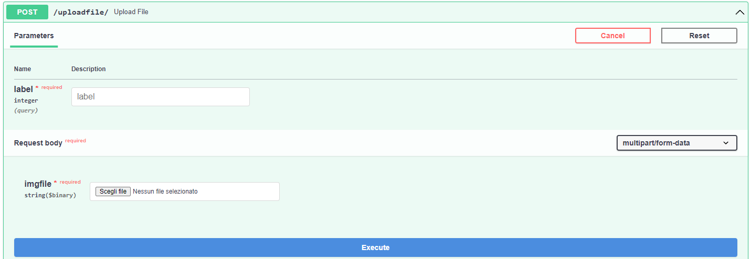
FastAPI endpoints
/uploadfile
REQUEST TYPE | INPUT | RESPONSE | POSSIBLE ERRORS | DESCRIPTION | PYDANTIC CLASS
POST | Image: UploadFile True Label: int | { “filename”: file.filename, “id”: id, “label”:label } | 500 - Internal server error 406 – Not acceptable | Stores an image with its true label to expand the dataset and reinforce the model. | ImageValidator LabelValidator

Slide 6
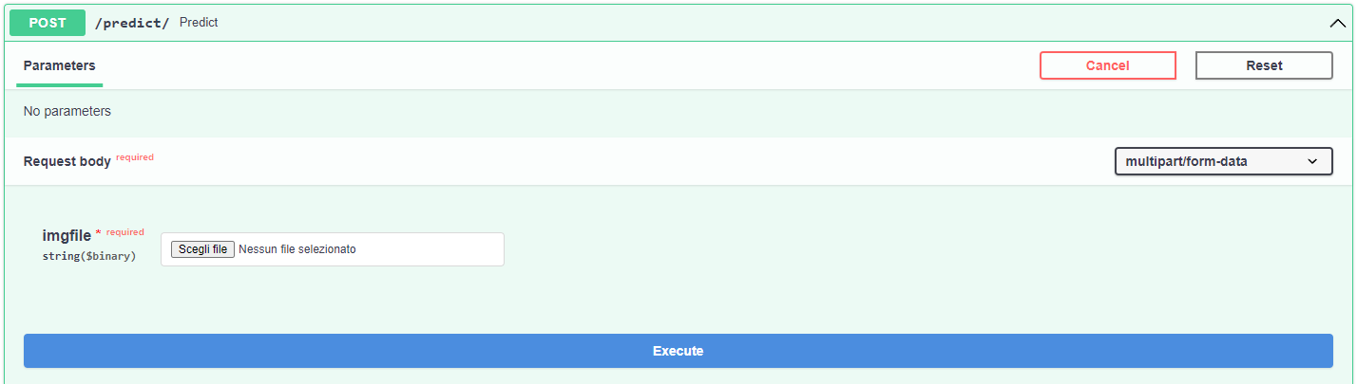
FastAPI endpoints
/predict
REQUEST TYPE | INPUT | RESPONSE | POSSIBLE ERRORS | DESCRIPTION | PYDANTIC CLASS
POST | Image: UploadFile | { “filename”: file.filename, “id”: id, “label”:label } | 500 - Internal server error 406 – Not acceptable | Accepts an image and performs the classfication task exploiting the pretrained model. | ImageValidator

Slide 7
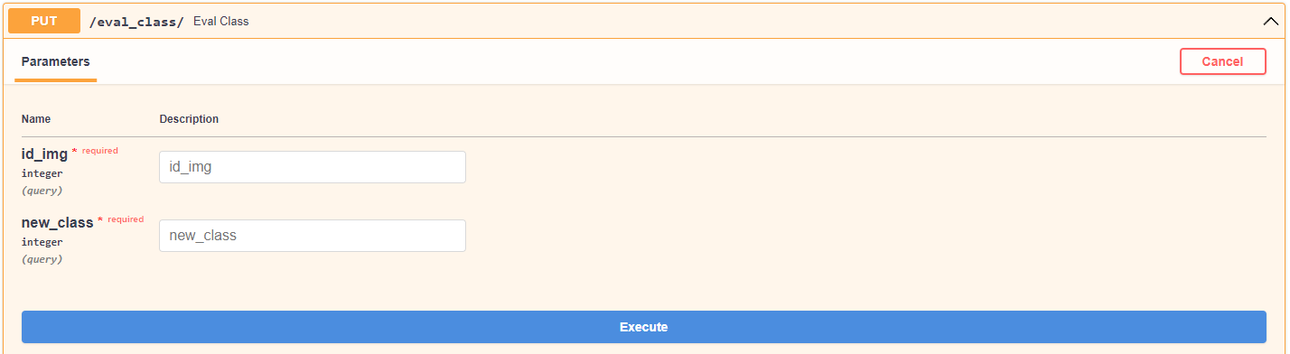
FastAPI endpoints
/eval_class
REQUEST TYPE | INPUT | RESPONSE | DESCRIPTION | PYDANTIC CLASS
PUT | Image ID: int New label: int | {"result": "ok, new class saved"} | Accepts an image id and changes the corresponding label to the one passed as input. | LabelValidator

Slide 8
Testing the endpoints
/uploadfile
METHOD | RESULT | DESCRIPTION | ASSERTIONS
test_upload_ok | PASSED | Asserts that the response status is OK and that the response json is well formatted and consistent. | Status = HTTPStatus.OK Response ={"filename": original_filename, "id": id, "label": label}
test_upload_ko_image | PASSED | Asserts that the response status is NOT ACCEPTABLE when a file different from an image is given. | Status = HTTPStatus.NOT_ACCEPTABLE Response= {'detail': 'Image upload error, the file provided is not an image.'}
test_upload_ko_id | PASSED | Asserts that the response is an error when a non valid class id is given. | Response = {'detail': 'Id label error, the label must be a value between 0 and 9.'}

Slide 9
Testing the endpoints
/predict
METHOD | RESULT | DESCRIPTION | ASSERTIONS
test_predict_ok | PASSED | Asserts that the response status is OK and that the response json is well formatted and consistent when a classification is made. | Status = HTTPStatus.OK Response = {"filename": original_filename, "id": id, "label": label}
test_predict_ko | PASSED | Asserts that the response status is NOT ACCEPTABLE when a file different from an image is given. | Status= HTTPStatus.NOT_ACCEPTABLE Response= {'detail': 'Image upload error, the file provided is not an image.'}

Slide 10
Testing the endpoints
/eval_class
METHOD | RESULT | DESCRIPTION | ASSERTIONS
test_eval_class_ok | PASSED | Asserts that the response status is OK and that the response json is well formatted and consistent. | Status = HTTPStatus.OK Response = {"result": "ok, new class saved"}
test_eval_class_ko_not_found | PASSED | Asserts that the response status is NOT FOUND the given ID of the image is not present in prediction.csv. | Status = HTTPStatus.NOT_FOUND Response= {'detail': 'There is no classified image with that id.'}
test_eval_class_ko_double | PASSED | Asserts that the response is NOT ACCEPTABLE there is already a class for the image in the dataset.csv file. | Status = HTTPStatus.NOT_ACCEPTABLE Response = {'detail': 'There is already a class specified for that that image id.'}

